Slide 1

Our Story
Est 2008

Slide 2


THE BEGINNING
2000–2005
I started delivering a small coaching programme, A C Tennis. It was delivered out of a local secondary school
2006
A disused local tennis club was brought to my attention

Slide 3
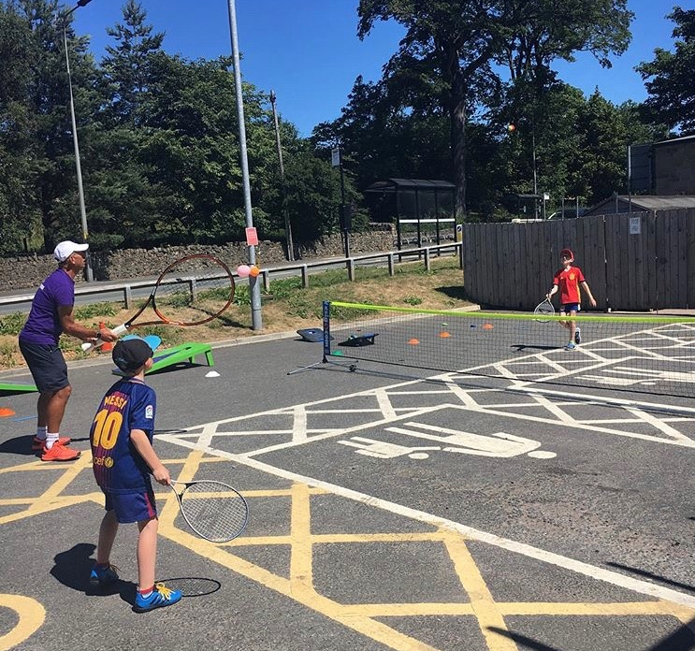
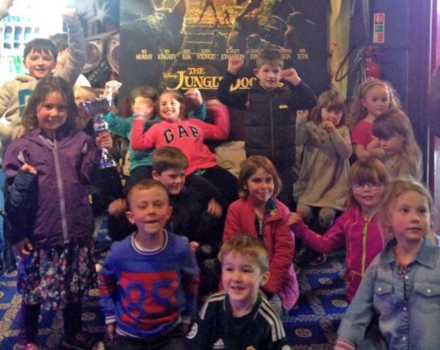
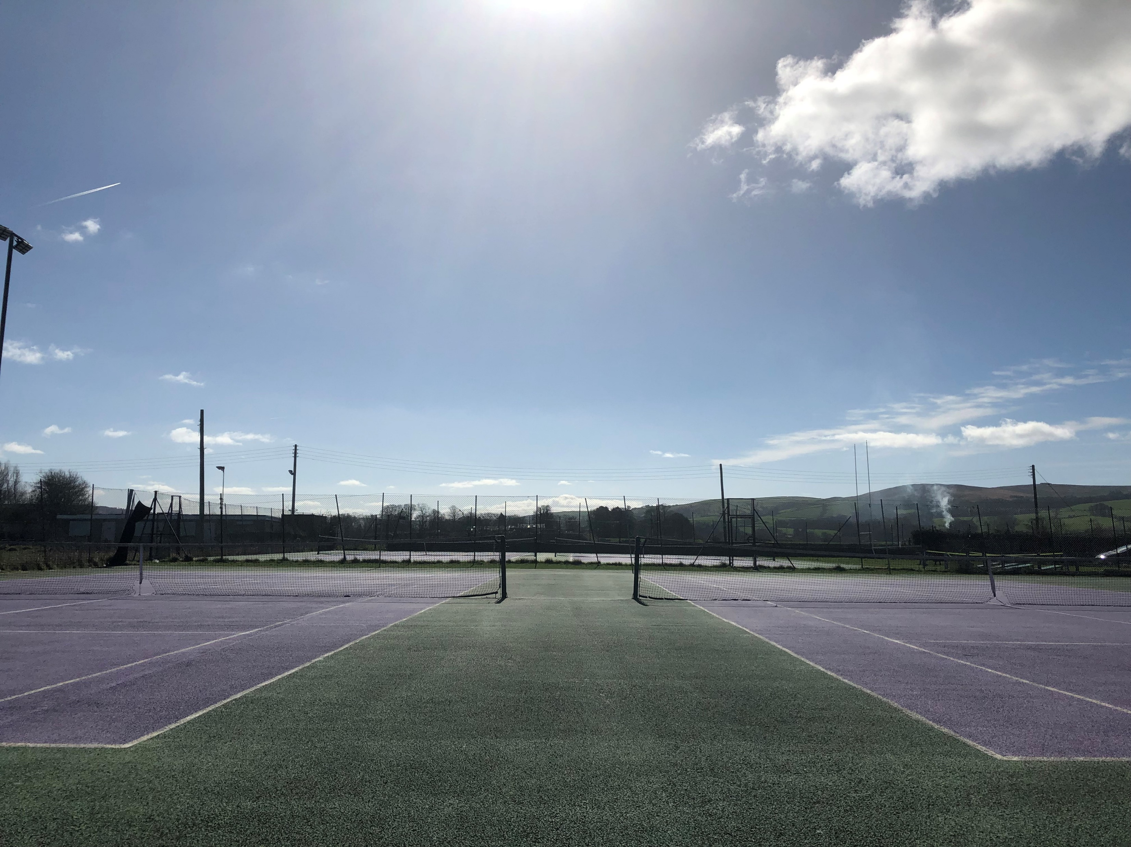
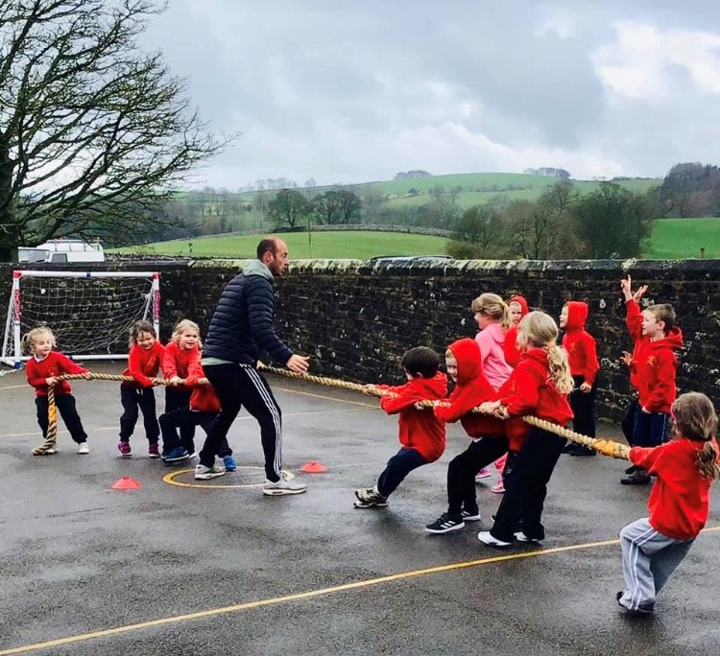
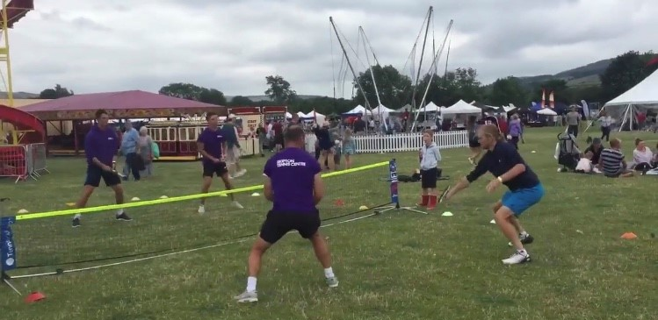
THE VISION
2006 – 2007
To build a tennis club that would unlock and open up tennis across Craven (North Yorkshire) ‘Tennis for Everyone’
Engage a community
Market the sport against competitors (other sports/activities)
Social media / website
Open days and innovative road shows
Use schools as a ‘shop window’

Slide 4
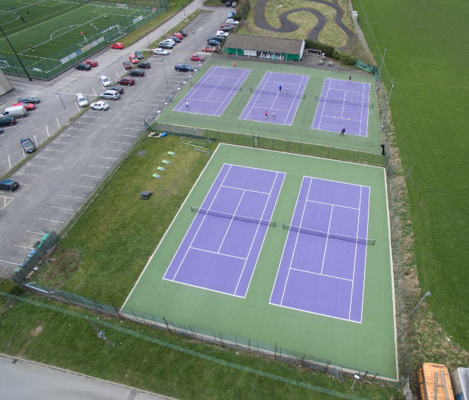
THE RESULT
2007 Participation = 0
2019 Participation 12 years Later =
300 players in weekly coaching sessions
15 competitive teams
Well attended social events
Private lesson portfolio –x4 coaches
Holidays clubs – summer 2018, 700 children attended over 6 weeks
Deliver weekly satellite session to 14 schools
A further 16 schools support the club
30+ 15 – 16-year old's have taken part in work experience at the club
5 of which are now Level 2 or 3 LTA coaches and still work in the industry
Coaching + members + private clients + schools = 1200+ players weekly
3X club sponsors- Keelham Farm Shop, Walker Foster Solicitors & Bradford Grammar School
Innovative open days collaborating with sponsors
Corporate team building packages
Links with USTA National Campus – Orlando, Florida

Slide 5
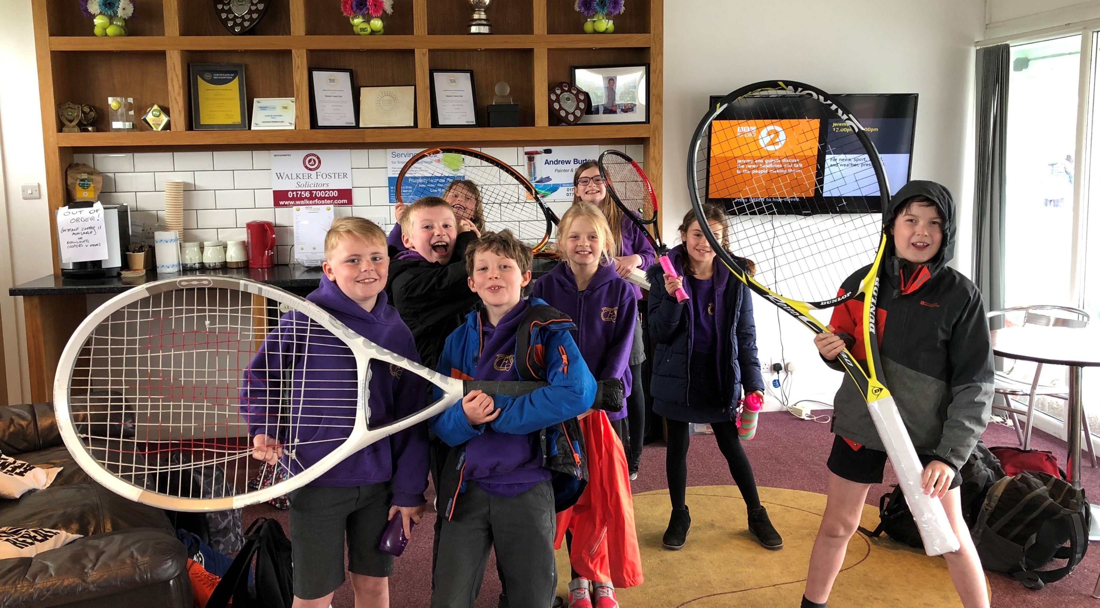
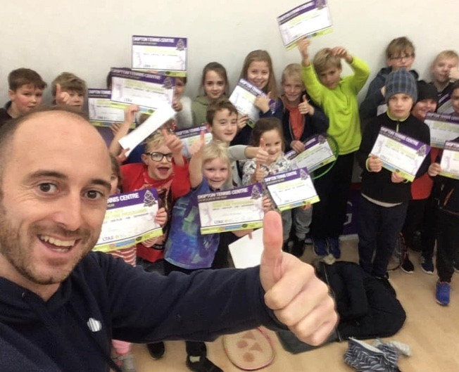

SCHOOL WORK
Foresight to look in to the PE premium, how and when this is spent
Coaches to cover PPA cover
Offering free taster sessions – preseason / pre summer camps
Free staff CPD – tennis to remain current
Inter School tournaments at the club to showcase what we can offer
All with the view of staying ahead of the competition of other clubs and other sports

Slide 6


SPONSORED PLAYER INITIATIVE
‘Tennis for Everyone’
New for 2019…
Buddy a sponsor with a player
1 years tennis (including a racket, footwear and club membership)
10 x players currently involved/active
£2000 raised from 10 local companies
The Bigger Picture…
1 club from each county rolled this out = 480 Players
10 clubs per county (approx. 6% of GB Clubs) = 4800 Players
All this at NO cost to the LTA or the Player
Financially 10 clubs x £2000 = £20k
48 Counties do something similar = £960K in to British tennis

Slide 7
KEY SKILLS
Tennis coaching and all-round knowledge
Marketing
Finances
Facility management and development
Communication
Sales
Ability to change and be diverse
Innovative, creative and thinking outside the box

Slide 8
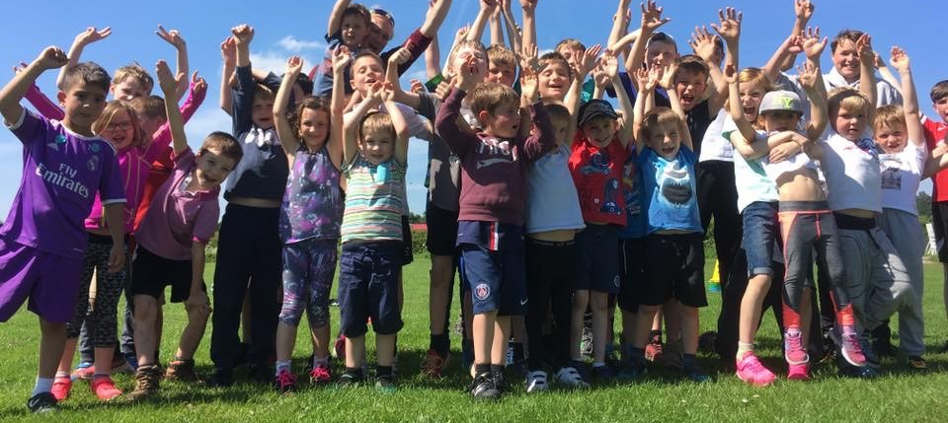
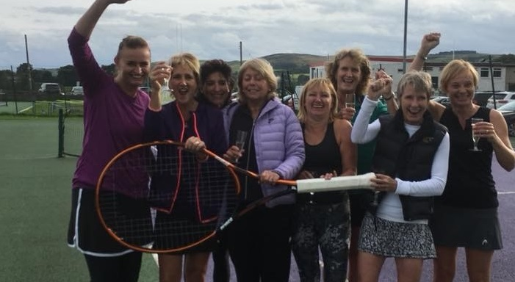
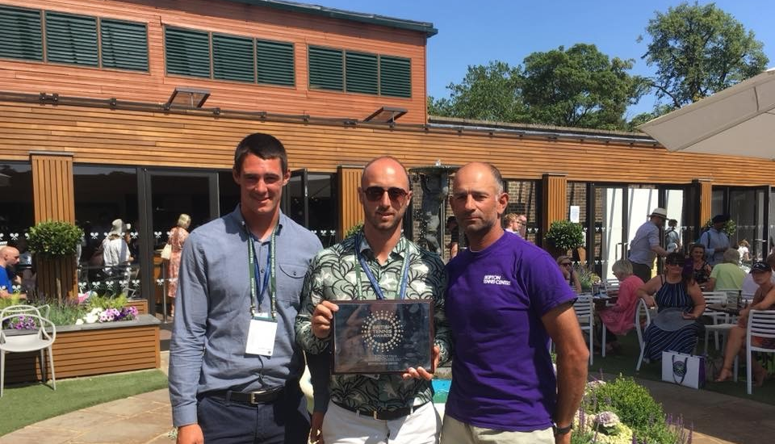
ACHIEVEMENTS
Building a 5 court club from scratch
Mixed team winning Division 1
Craven Community Sports Award 2017
Seeing friendships flourish and people having fun whist playing tennis
Creating a club where tennis really is for anyone and everyone
USTA Radar
Best of all…
WINNER of LTA Yorkshire, Regional and National Club of the Year 2017/18
Thanks to Alex and Abi for all their efforts
Asked today to present to the LTA Council

Slide 9
THANKS
LTA for taking a risk
LTA North Region for their continued Support –
Gavin Sutcliffe & Paul Bennett
Yorkshire Tennis for the continued support
£75k Loan has now been fully repaid

Slide 10
THE FUTURE
The club and team will continue to stay motivated and creative and will continue to grow participation
Stay current in our community and continue to give people a reason to pick up a racket
Facility Development
Enhance the tennis experience by improving the facility. Currently the feel is that we are doing a 1st class job ensuring ‘Tennis is for Everyone’ with 3rd class facilities.
We have financial support our local authority in the way of section 106 Planning Gain
We are hoping Yorkshire will gain a regional performance centre so we can direct more juniors to county training.

Slide 11
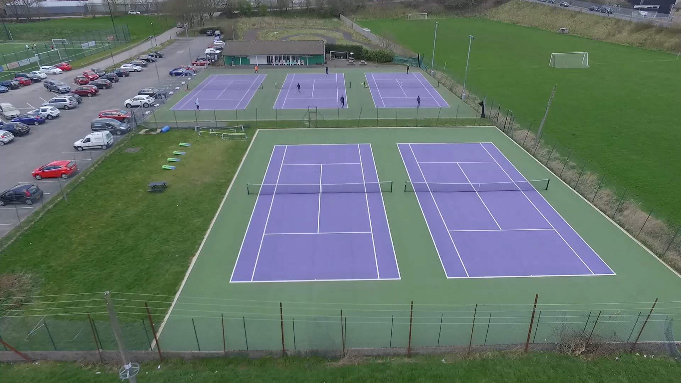

Slide 12
Any Questions?

